Slide 1
Zyxel Icon/Logo Library
2024/Feb/19

Slide 2
Zyxel Networks Logo & Promotion Logo
01
Zyxel Networks
02
Nebula
03
Zyxel One Network

Slide 3
E-Commerce Logo
01
Circle
02
Zyxel
Marketplace
03
Zyxel Store

Slide 4
Product Icon
01
Home Connectivity
02
Security
03
Networking
WiFi Router
WiFi System
WiFi Extender
DSL CPE
Powerline
Personal Cloud Storage
Firewall
Gateway
Switch
Wireless
Mobile Broadband
04
Service Provider
General icon (for application diagram usage)

Slide 5
Application Icon
01
Green Set
02
Orange Set

Slide 6
Feature Icon
01
Template

Slide 7

Line Color for Application Diagram
Topology Usage
R255 G200 B0
Line: 1 pt
Fiber 1000 Mbps
R0 G0 B0
Line: 0.5 pt
Ethernet
R255 G200 B0
Line: 2.5 pt
Fiber 10G
R0 G0 B0
Line: 0.5 pt
Ethernet 10/100 Mbps
R180 G180 B180
PoE
R0 G0 B0
Line: 1 pt
Ethernet 1000 Mbps
R180 G180 B180
1000 Mbps/PoE
R0 G79 B238
Copper/DSL/Phone Line
R232 G128 B0
Coaxial Cable
R60 G159 B0
R255 G200 B0
AV/HDMI/RCA Cable
R217 G0 B60
R195 G97 B0
RS232 Cable
R0 G79 B238
Powerline
R0 G0 B0
USB Cable

Slide 8









Wireless Wave
Line Color for Application Diagram
Red
Green
Orange
2.4 G
3 G
2.4+5 G
4 G
5G

Slide 9
Zyxel Networks Logo & Promotion Logo

Slide 10



Zyxel Networks

Slide 11


Zyxel Nebula

Slide 12


Zyxel One Network

Slide 13
E-Commerce Logo

Slide 14
Zyxel Circle

Slide 15
Zyxel Marketplace

Slide 16
Zyxel Store

Slide 17
Product Icon

Slide 18
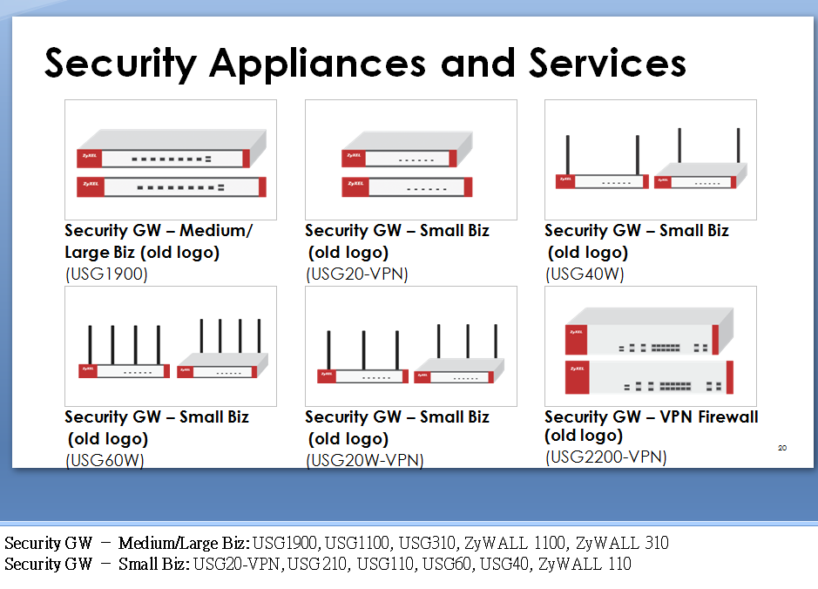
How to Use Product Icon
Product icons can be shared by multiple models, pls refer to the suggested model list below.

Slide 19
Product Icon – Home Connectivity
01

Slide 20
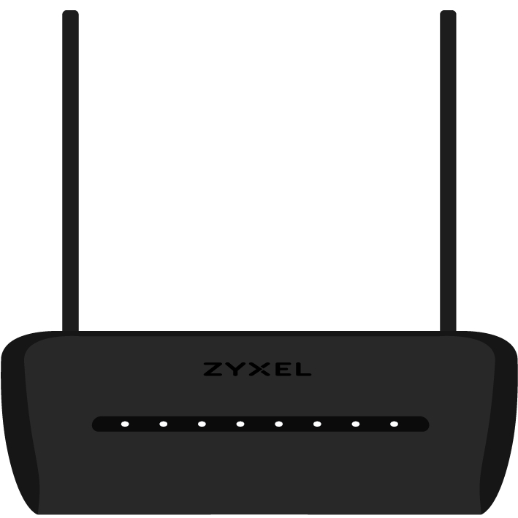
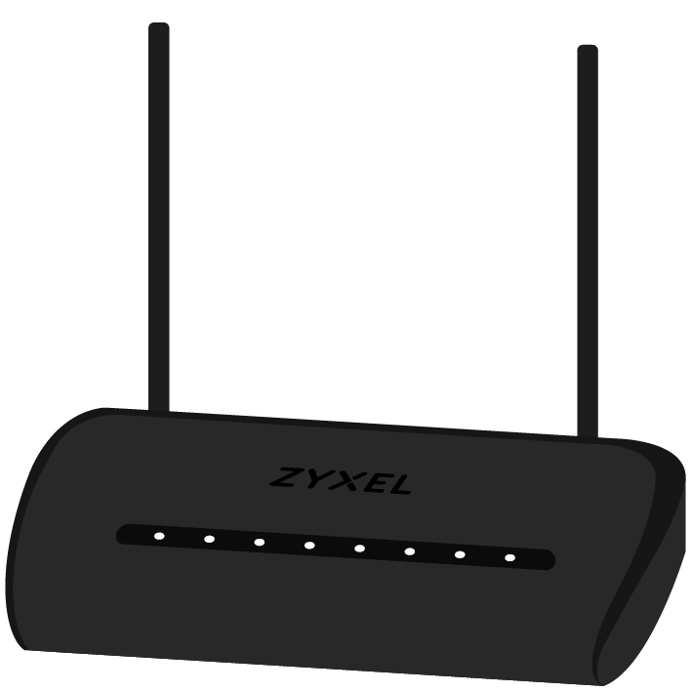
WiFi Router
Router
(NBG6616)
Notes:
Router: NBG6616, NBG6515, NBG-418N v2

Slide 21


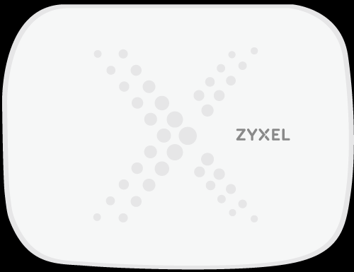
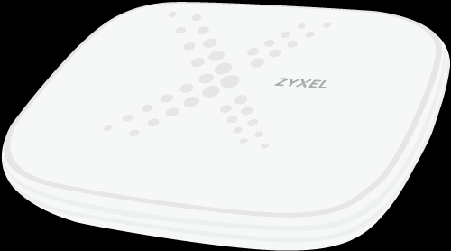
WiFi System
Multy
(Multy X)
Multy U
Notes:
Multy: Multy X, Multy Plus, Multy Mini
Multy U

Slide 22
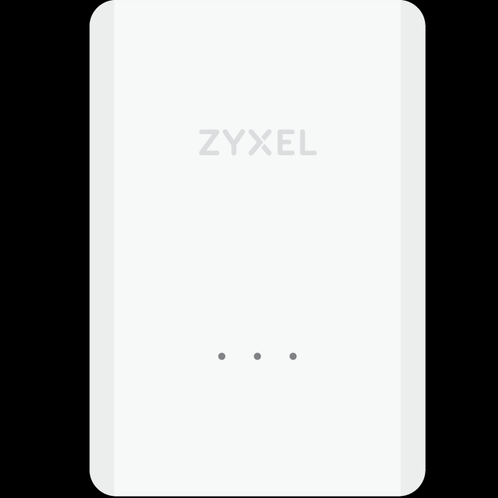
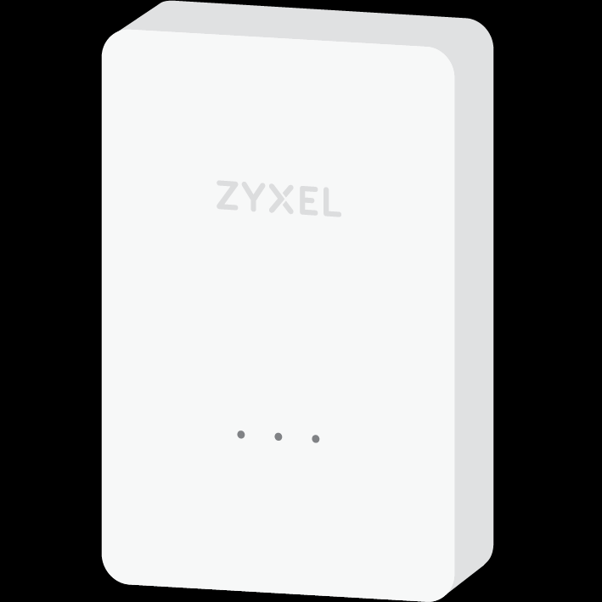
WiFi Extender
Range Extender
(WRE6606)
Notes:
Range Extender: WRE6606

Slide 23
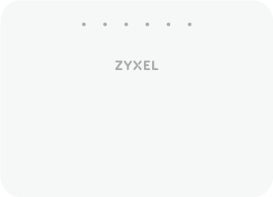
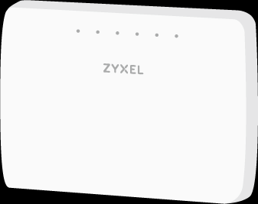
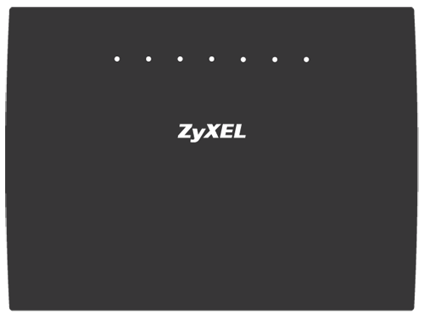
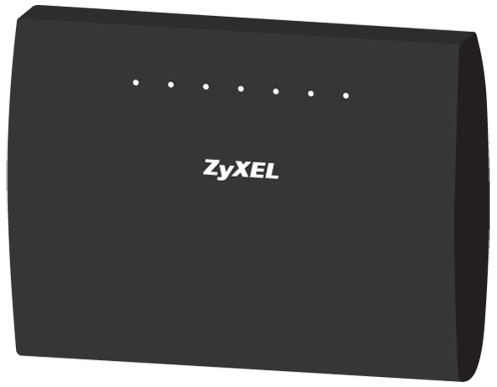


DSL CPE
DSL CPE (white, upright type)
DSL CPE (black, upright type)
DSL CPE (black, flat type)
Notes:
DSL CPE (white, upright type): VMG3625-T50B, VMG8825-T50K
DSL CPE – VMG1312 (Upright type): VMG3312-T20A
DSL CPE (Flat type) : VMG1312, VMG1312-B30A

Slide 24
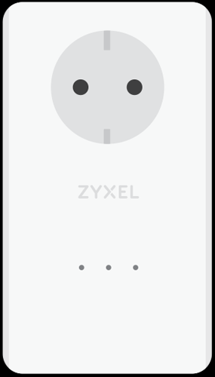
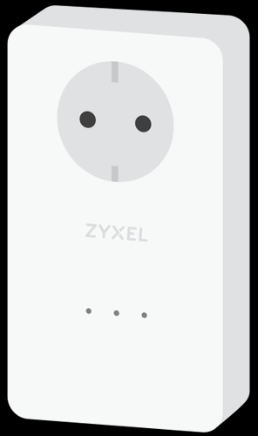
Powerline
Pass-through Adapter
(PLA5456)
Adapter
(PLA5206 v2)
Notes:
Pass-through Adapter: PLA5456, PLA5256, PLA6456
Adapter: PLA5206 v2, PLA5405 v2

Slide 25


Personal Cloud Storage
NAS
(NAS540)
Notes:
NAS: NAS542, NAS540, NAS520, NAS326

Slide 26
Product Icon - Security
02

Slide 27




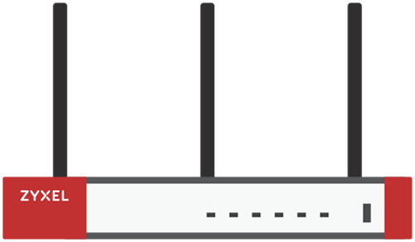
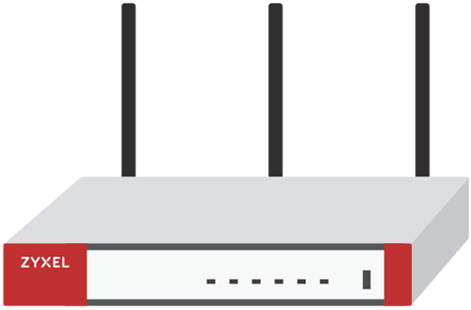

Firewall
Security GW – Large Biz
(ATP800)
Security GW – Medium Biz
(ATP500)
Security GW – Small Biz
(ATP200)
Security GW - Small Biz
(ATP100)
Security GW - Small Biz
(ATP100W)
Notes:
Security GW – Large Biz : ATP800/ATP700
Security GW – Medium Biz : ATP500/VPN300
Security GW – Small Biz: ATP200/VPN100

Slide 28


Firewall
Security GW – Medium Biz
(USG FLEX 700)
Security GW – Medium Biz
(USG FLEX 500)
Security GW – Small Biz
(USG FLEX 200)
Security GW – Small Biz
(USG FLEX 100)
Security GW – Small Biz
(USG FLEX 100W)
Security GW – Medium/ Large Biz
(USG2200)

Slide 29

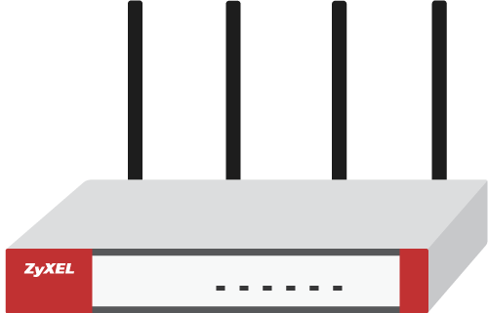
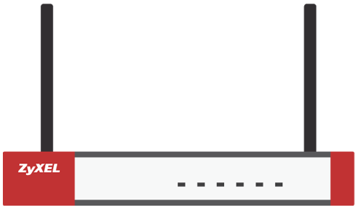
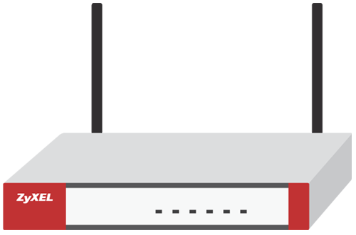
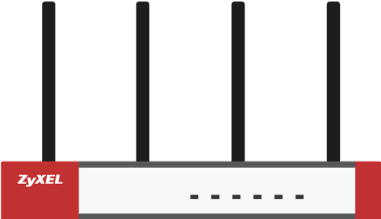



Firewall
Security GW – Medium/
Large Biz (old logo)
(USG1900)
Security GW – Small Biz
(old logo)
(USG60W)
Security GW – Small Biz
(old logo)
(USG40W)
Security GW H Series
(USG FLEX 200H)
Notes:
Security GW H Series: USG FLEX 200H/100H/500H/700H
Security GW – Medium/Large Biz: USG1900, USG1100, USG310, ZyWALL 1100, ZyWALL 310

Slide 30

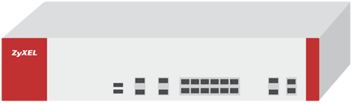
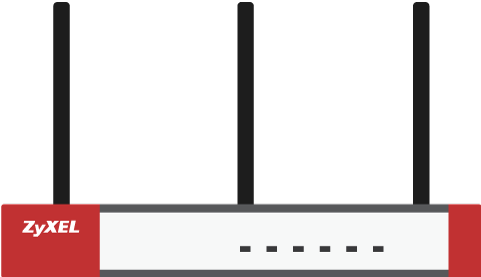
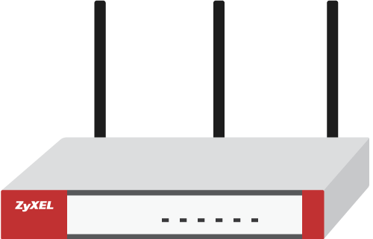

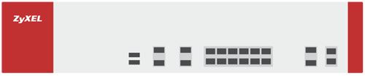
Gateway
Security GW – Large Biz
(VPN1000)
Security GW – Small Biz
(VPN50)
Security GW – Small Biz
(VPN20W)
Security GW – Small Biz
(old logo)
(USG20-VPN)
Security GW – Small Biz
(old logo)
(USG20W-VPN)
Security GW – VPN Firewall (old logo)
(USG2200-VPN)
Notes:
Security GW – Small Biz: USG20-VPN, USG 210, USG110, USG60, USG40, ZyWALL 110

Slide 31




Gateway
Nebula Gateway
(NSG100)
Nebula Gateway
(NSG300)

Slide 32
Product Icon - Networking
03

Slide 33


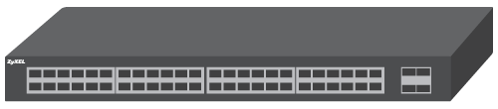



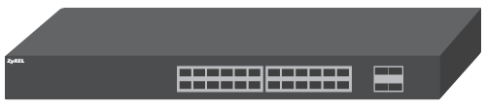



Switch
XGS4600-32/32F
XGS4600-52F
XGS3700-48/48HP
GS3700-48/48HP
(old logo)
XGS3700-24/24HP
GS3700-24/24HP
(old logo)
XS3800-28

Slide 34

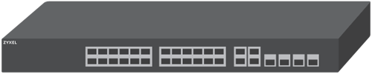





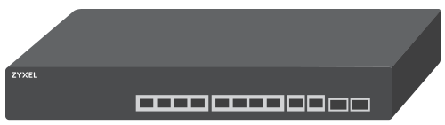


Switch
GS2220-50/50HP
GS2220-28/28HP
GS2220-10HP
GS2220-10
XGS2210-28/28HP
(old logo)
XGS2210-52/52HP
(old logo)

Slide 35


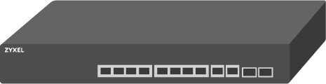
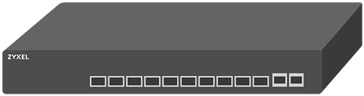


Switch
GS2210-48/48HP
(old logo)
GS2210-24/24HP/24LP
(old logo)
XGS1930-28/28HP
XGS1930-52/52HP
XS1930-12HP
XS1930-12F

Slide 36
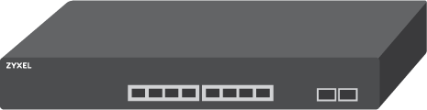

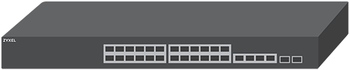



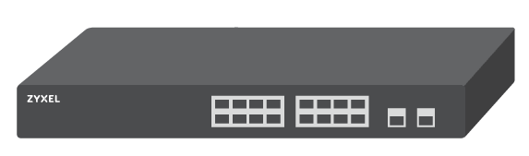
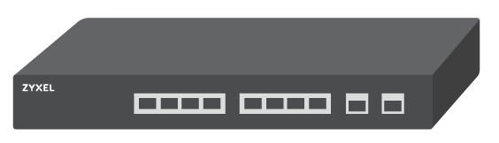
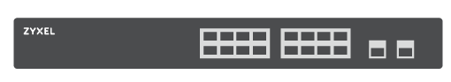
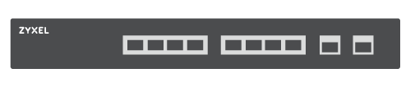
Switch
XS1930-10
XS1920-12
(old logo)
XMG1930-30/30HP
XMG1915-18ep
XMG1915-10e/10ep
GS1920-48v2/48HPv2

Slide 37
Switch
GS1920-24v2/24HPv2
GS1920-8HPv2
GS1915-24EP
GS1915-24E
GS1915-8EP
GS1915-8

Slide 38
Switch
GS1900-48/48HP
GS1900-24
GS1900-24HPv2
GS1900-24E
GS1900-24EP
GS1900-16

Slide 39
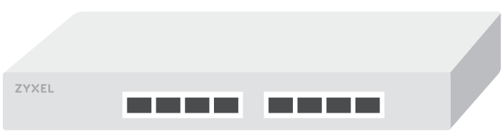

Switch
GS1900-10HP
GS1900-8
GS1900-8HP
XGS1250
GS1200-8HP
Notes:
Desktop Switch: GS1200-5HP/GS1200-8HP, GS-105B v3/GS-108B v3, GS-105I/GS108I, ES-105A v3/ES-108A v3, ES-105E/ES-108E

Slide 40
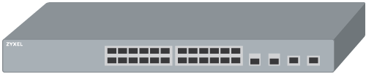
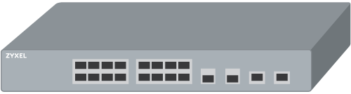




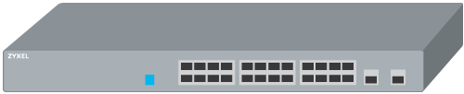
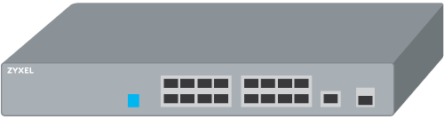




Switch
GS1350-26HP
GS1350-18HP
GS1350-12HP
GS1350-6HP
GS1300-26HP
GS1300-18HP

Slide 41












Switch
GS1300-10HP
GS1100-24E
GS1100-24
GS1100-16
GS1100-10HP
ES1100-24/24E
(old logo)

Slide 42

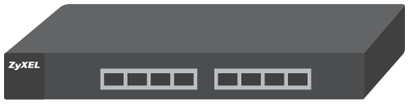


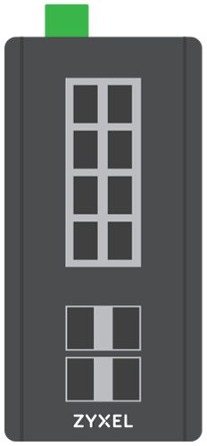
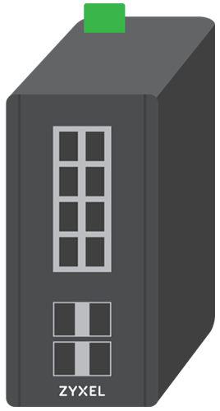


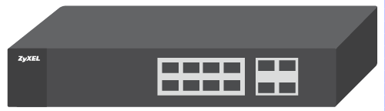

Switch
ES1100-16/16P
(old logo)
ES1100-8P
(old logo)
ES3500-24
(old logo)
ES3500-8PD
(old logo)
RGS200-12P
RGS100-5P

Slide 43
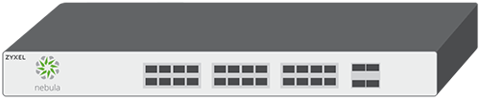





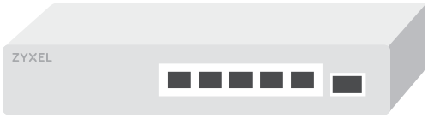
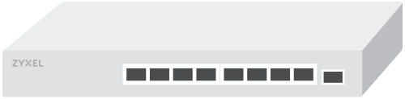


Switch
Nebula Switch – 24-port
(NSW100-28P)
Nebula Switch – 8-port
(NSW100-10)
MG-105
XMG-105HP
XMG-108/108HP
Notes:
Nebula Switch– 24-port: NSW100-28P, NSW100-28, NSW200-28P
Nebula Switch– 8-port: NSW100-10, NSW100-10P

Slide 44
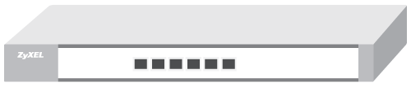
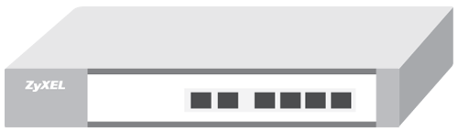
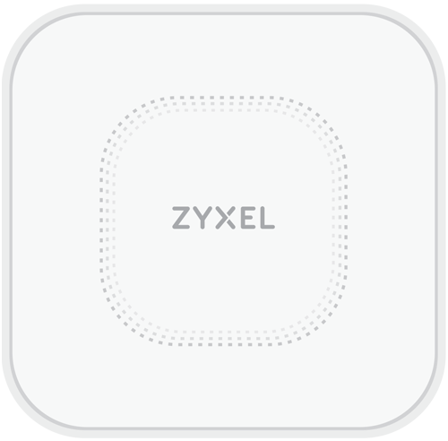









Wireless
Controller (old logo)
(NXC5500)
Controller (old logo)
(NXC2500)
Indoor AX AP
(WAX650S)
Indoor WiFi 6E AP
(WAX640S-6E)
Indoor WiFi 6E AP-1
(WAX620D-6E)
Indoor AP
(WAC6303D-S)
Notes:
Indoor WiFi 6E AP-1: WAX620D-6E, NWA220AX-6E
Indoor AX AP: WAX650S, WAX610D, WAX510D, WAC500, NWA210AX, NWA110AX, NWA50AX, NWA1123ACv3
Indoor AP (new logo): WAC6303D-S, NWA1123-AC HD, NWA5123-AC HD

Slide 45












Wireless
Indoor AP (old logo)
(WAC6502D-S)
Indoor AP
(NWA5123-AC)
Outdoor AP (old logo)
(WAC6553D-E)
Indoor AP (old logo)
(NWA5301-NJ)
Indoor AP
(WAC5302D-S)
Outdoor WiFi 6E AP
NWA55AXE
Notes:
Indoor AP circle shape (new logo): NWA5123-AC, NWA1123-ACv2, NAP102
Indoor AP (old logo): WAC6502D-S, WAC6503D-S, WAC6103D-I, NWA1123-AC PRO, NAP303, NAP203
Indoor AP: WAC5302D-S, NWA1302-AC

Slide 46










Mobile Broadband
Outdoor Router
(LTE7460)
Indoor Router
(LTE3316)
Indoor Router
(LTE3301)
Indoor Router / IAD
(LTE5366)
Indoor Router
(LTE5388)
Indoor Router / IAD
(LTE3302)
Notes:
Outdoor CPE: LTE7460 ,LTE7460-M608, LTE7461, NR7101, LTE7490, LTE7480
Indoor Router: LTE3316, LTE3202

Slide 47


Mobile Broadband
Portable Router
(WAH7706)

Slide 48
Product Icon – Service Provider
(General icon for application diagram drawing usage)
03

Slide 49










MSANs/DSLAMs
1U (old logo)
(VES1724)
2U
(IES4105)
5U (old logo)
12U (old logo)
  G.fast DPU
(GES2104)
Notes:
1U: IES-1248-51, IES-1000 Series, IES-612-51, VES1724-56B2, VES1724-55C
2U: IES4105 (IES4105M), IES4005 Series, IES4005M
5U: IES-5106 Series , IES-5106M, IES5206 Series IES5106M
12U: IES-6000 Series, IES-5112 Series, IES-5112M

Slide 50








Fiber Access
1U GPON OLT
(OLT1404/OLT1408)
2U GPON OLT (old logo)
(OLT2406)
4 ports GPON ONT
(PMG5323-B20B)
1 port GPON ONT (old logo)
(PMG1005-T20A)
Notes:
4 ports GPON ONT: PMG5323-B20B, PMG5318-B20C

Slide 51
Ethernet Gateways
Ethernet CPE
(EMG2306)
Notes:
Ethernet CPE: EMG2306 EMG2306-R10A, EMG1302

Slide 52
Application Icon

Slide 53
Application Icon - Green Set
01

Slide 54




Devices – Portable Handheld
Smartphone
Tablet PC
USB disk
USB mass storage device

Slide 55








Devices – PC & Peripherals
Laptop
Desktop
Kiosk
POS + Push ADs
Edge Label Switch Router
3G/4G Dongle
OLT/Switch
Monitoring Equipment

Slide 56








Devices - Home Stereo & Entertainment
Smart TV
Game console
Video game console
Headset
Blue-Ray Player
Speaker
Remote Controller
IP STB

Slide 57





Devices - Home Stereo & Entertainment
Google Chromecast V1
Google Chromecast V2
Apple TV
Video
Virtual Assistant
AR/VR
Conference Call

Slide 58




Devices – Phone, Printer and Fax
IP phone/Phone
Mfp Printer
Printer
Fax Machine

Slide 59





Devices - Camera
IP camera
Analog Camera
Web Camera
Camera
Digital Camcorder

Slide 60








Devices – Wall Outlet
Wall outlet 1
Wall outlet 2
Phone Jack
Indoor Splitter
Coaxial outlet
Copper line
Fiber line
Coaxial line

Slide 61



Devices – BS & Antenna
Antenna
Antenna tower
Pole

Slide 62



Devices – Servers
Server
Street cabinet
Storage

Slide 63








Building
Home
Branch office
Headquarters
Retail Store
Boutique Hotel
Campus
Department Store
Outdoor

Slide 64

Building
Swimming Pool
Stadium

Slide 65

Vehicle
Vehicle Train

Slide 66








Symbol - 1
Internet
3G/4G/IP/PSTN network
Wi-Fi 2.4 GHz
Wi-Fi 5 GHz
Firewall
Wi-Fi
User
Money

Slide 67








Symbol - 2
Optical Splitter
Fiber Ring
Router
Switch
Storage
Stopwatch –
10 seconds
Stopwatch –
30 seconds
Stopwatch –
60 seconds

Slide 68




Symbol - 3
Alert
Snowflake
Sun
Thermometer

Slide 69
Application Icon - Orange Set
02

Slide 70




Devices – Portable Handheld
Smartphone
Tablet PC
USB disk
USB mass storage device

Slide 71








Devices – PC & Peripherals
Laptop
Desktop
Kiosk
POS + Push ADs
Edge Label Switch Router
3G/4G Dongle
OLT/Switch
Monitoring Equipment

Slide 72








Devices - Home Stereo & Entertainment
Smart TV
Game console
Video game console
Headset
Blue-Ray Player
Speaker
Remote Controller
IP STB

Slide 73





Devices - Home Stereo & Entertainment
Google Chromecast V1
Google Chromecast V2
Apple TV
Video
Virtual Assistant
AR/VR
Conference Call

Slide 74




Devices – Phone, Printer and Fax
IP Phone/Phone
Mfp Printer
Printer
Fax Machine

Slide 75





Devices - Camera
IP camera
Analog Camera
Web Camera
Camera
Digital Camcorder

Slide 76








Devices – Wall Outlet
Wall outlet 1
Wall outlet 2
Phone Jack
Indoor Splitter
Coaxial outlet
Copper line
Fiber line
Coaxial line

Slide 77



Devices – BS & Antenna
Antenna
Antenna tower
Pole

Slide 78



Devices – Servers
Server
Street cabinet
Storage

Slide 79








Building
Home
Branch office
Headquarters
Retail Store
Boutique Hotel
Campus
Department Store
Outdoor

Slide 80

Building
Swimming Pool
Stadium

Slide 81

Vehicle
Vehicle Train

Slide 82








Symbol - 1
Internet
3G/4G/IP/PSTN network
Wi-Fi 2.4 GHz
Wi-Fi 5 GHz
Firewall
Wi-Fi
User
Money

Slide 83








Symbol - 2
Optical Splitter
Fiber Ring
Router
Switch
Storage
Stopwatch –
10 seconds
Stopwatch –
30 seconds
Stopwatch –
60 seconds

Slide 84




Symbol - 3
Alert
Snowflake
Sun
Thermometer

Slide 85

Feature Icon
01

Slide 86

How to Use color changeable feature icons
Tired of selecting different color icons all the time? Newly released feature icons allow you to simply right click to change icon colors.
How to:
Right click the icon
Select the bucket icon
Select Zyxel 5 corporate primary colors ONLY.

Slide 87
Cloud
Cloud Upload
Cloud Download
Cloud Upload/ Download
Cloud Management
/Setting
Hybrid

Slide 88
Hardware - 1
USB Support
CPU
SD Card
eSIM
Switch
Two-way Audio
Outlet
Powerline Homeplug
Fan
Fanless

Slide 89
Hardware - 2
Temperature
HDD
RAID
Degree Angle

Slide 90
LAN/PoE/Power - 1
Ethernet/LAN/ WAN
PoE
Intelligently
Monitor PoE
Multiple WANs
Multiple SSID &
VLAN Support
Dual Power
Power Button
Power/
Surge Protection
Battery
DCS

Slide 91
LAN/PoE/Power - 2
SFP+

Slide 92
Management/Set up - 1
Setup
Auto Config/ Setting/
Deployment
Management
Setting
Remote Management
Backup
Sync
Upload/
Download
Bandwidth Management QoS
Easy Installation
Eco Power Management

Slide 93
Management/Set up - 2
OPAL Operating System
IP66, IP67, IP68
Wind Load Testing
UV Stabilized Plastic

Slide 94
Networking - 1
LIC-SecuExtender VPN Client
Load Balancing
Comprehensive Connectivity
VPN Throughput
Cloud VPN
VPN
IPv6
LIC-GEO Enforcer
Map, Floor Plan, Location
Routing

Slide 95
Networking - 2
Multiple APN
Scheduling Task
SSL Packet
Inspection
VDSL/ADSL
VoIP
VoLTE CSFB Calls
BSS Coloring/
LIC-CDR
QAM
CBRS
SAS

Slide 96
Networking - 3
FOTA
4G LTE
5G NR

Slide 97
Security/Protection-1
Security
Firewall
3G/4G Interference Immunity
LIC-Reputation Filter
LIC-Single Sign-On
LIC-Web Filtering/ Content Filtering
LIC-Email Security/
Anti-Spam
Application Security
Prevention/ SHA2 security
LIC-SecuReporter

Slide 98
Security/Protection-2
Botnet Filter
LIC-Anti-Malware/ Virus
LIC-Sandboxing
VPN High
Availability (HA)
LIC-Device High Availability Pro
Basic Pack/
UTM Pack
Plus Pack/
Silver Pack
Professional Pack/
Gold Pack
MSP Pack
SCR PRO Pack

Slide 99
Security/Protection-3
SecuManager
Lic-SSL
Malware Blocker
LIC-Cloud Email Security
LIC-Astra
LIC-IPS/IDP
LIC-FAAS

Slide 100
Speed
Wireless Speed
Ultra-fast Speed
Quick/Fast

Slide 101
User-1
User Friendly
Number of users
Multi-tenant
service portal
Wizard
Alliance Partner
Authentication
Warranty
Multi-Mode
Global Sharing database
FAQ

Slide 102

User-2
Tips
Feedback
User Guide
Simplicity
Flexibility
Ultimate
Cost-Efficient

Slide 103
Web/Content Management
Web/Browser
Web GUI Redirection
Search
Expandability
Dual-Mode Firmware

Slide 104

Wireless/Antenna-1
802.11n # Mbps
802.11ac # Mbps
802.11ax # Mbps
802.11be # Mbps
Multi-band Support
Wireless coverage
Dual-band
Tri-band
Integrated WLAN controller
Antenna

Slide 105

Wireless/Antenna-2
Smart Antenna
LIC-Managed AP Service
LIC-Hotspot Management
LIC-Secure WiFi
WiFi 6E
WiFi 7
Beamforming
Wireless Layer-2
Isolation
OFDMA
LIC-CNP

Slide 106

Wireless/Antenna-3
Wider Channels
Contiguous Spectrum
Dual-Optimized Antenna
Extend coverage
dBm
Bandwidth Channels

Slide 107
Zyxel Utility/Application
Zyxel App
ZON
ZAC
ZWO
ZyMesh
Game Console
Multimedia/ Streaming
Full HD
LIC-Application Patrol
Printer/Document

Slide 108
Monitoring Detection
Motion Detection
Night Vision
Monitoring
Notification
Proximity Sensor for LED
OLED Display

